Slide 1
EZ WH -notes

Slide 2
Official requirements + APIs
Starting point for design, coding, testing
May contain defects – in case you find one, signal it with GIT issues
In case of conflicts OfficialRequirement vs API, API prevails

Slide 3
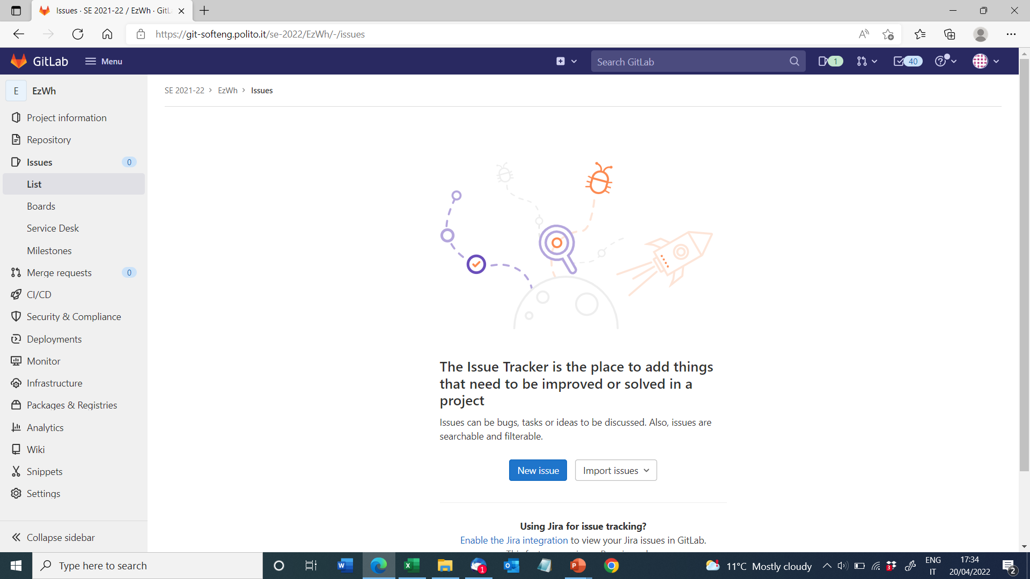

Slide 4
GIT issues
A defect
A request of work (task in Gantt)
Has a state (open, assigned to, closed)
Has a tag / label
Use Git issues also for coordination inside your team

Slide 5
Requirements
Context diagram
Data base as external actor - why?

Slide 6
Requirements
System design
Is list of sw + hw components that are part of the system
== are inside the context diagram, vs actors that are outside

Slide 7
Estimation

Slide 8
“estimate by size fails to take into account things like requirement, design time, testing
“the estimation by size isn't too accurate, as it just considers the total lines of code instead of taking into account the whole project development process”
NO
productivity = loc / effort (effort includes effort for design, testing etc

Slide 9
“here we are considering that the four teammates are working always at the same time and with a productivity of 100%: that's of course not always true.”
NO
productivity contains coffee breaks, meetings, and whatever ‘lost time’

Slide 10
Right now, you miss historical data about your past performance as a team
past productivity? size of classes?
This will be available at the end of the project

Slide 11
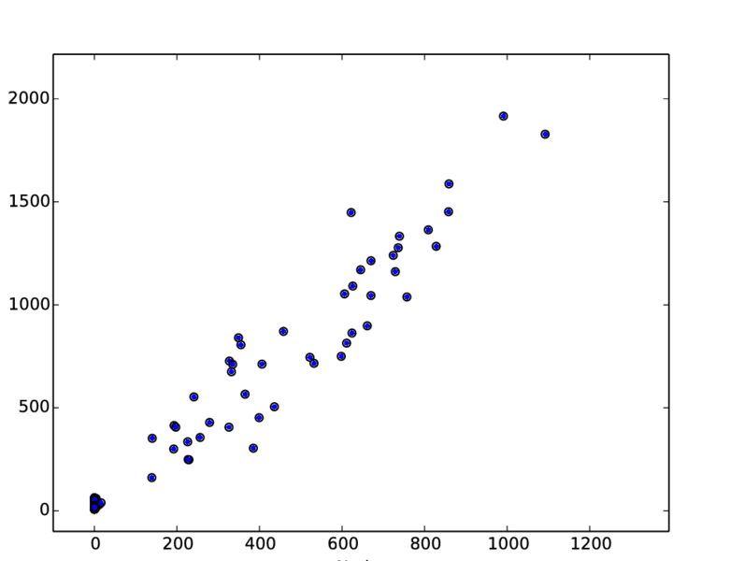
Estimation
Requires data from the past
effort
size

Slide 12
Design
Normal case: complete freeedom in decisions
GUI Application logic
Data

Slide 13
Design
This course need to manage 70 teams / project
Requirements are the same for all teams
Part of design is mandatory for all teams
Test is the same for all teams

Slide 14
Design
This course
API: functions (names and parameters exchanged) including types of data, exceptions
No change
GUI
No change
No change
API
free

Slide 15
Design
API is example of Facade pattern

Slide 16
Design vs testing
Standard GUI test cases
GUI
Standard API test cases
API

Slide 17
Design
What about authentication?
What about access rights?
Manager can do everything
Supplier can do certain things, not others

Slide 18
Design
Right now, do not consider the problem
A JS component will be used to handle this problem
In your design consider only one type of user that can do everything

